Slide 1

java.util Package
Session 20

Slide 2
Review
A package is a group of related classes or files.
We can create our own package by including the package command as the first statement in our Java code.
The classes in a package must be saved under a folder that bears the same name as the package.
The java.lang package is imported by default into every Java program.
Wrapper classes encapsulate simple primitive data types in the form of classes.
A String literal in Java is an instance of the String class.
The String class provides a variety of methods for searching and extracting portions of Strings.
Though Strings themselves cannot be modified directly we can create new Strings by applying certain methods on them.
The StringBuffer class is used as a building block for building Strings.

Slide 3
Review Contd…
Strings are immutable which means they are constant and their value cannot be changed.
Math is a final class that defines methods for basic numeric operations as well as geometric functions.
The Runtime class encapsulates the runtime environment and is typically used for memory management and running additional programs.
The System class allows us to access the standard input, output and error streams, provides means to access properties associated with the Java runtime system and various environment properties.
The Object class is the superclass of all classes.
Instances of Class encapsulate the run time state of an object in a running Java application.
Multithreading support in Java is provided by means of the Thread and ThreadGroup classes and the Runnable interface.

Slide 4
Objectives
  Explain the classes such as:
    Date
    Calendar
    Random
  Discuss about Collection classes and interfaces
  Describe legacy classes and interfaces
  List the Map classes and interfaces
  Discuss Regular Expression

Slide 5


Date class
Date class represents date and time.
Provides methods for manipulating the date and time components.
One of the best application of the Date class is in the creation of a real time clock.

Slide 6
Date class constructors
Constructor | Purpose
Date() | Creates a Date using today’s date.
Date(long dt) | Creates a Date using the specified number of milliseconds since January 1, 1970.
Date( int yr, int mon, int dt) | Creates a Date using the specified year, month and day.

Slide 7
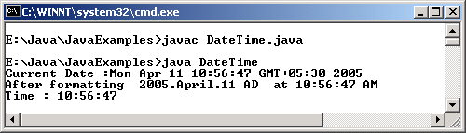
Example
import java.util.*;
import java.text.*;
class DateTime
{
public static void main(String args[])
{
String strDate, strTime = "";
SimpleDateFormat sdfFormat;
DateFormatSymbols dfsLocales;
// Create a US English locale
dfsLocales = new DateFormatSymbols(new Locale("en","US"));
// Create a pattern to format the date
// as per the US English locale
sdfFormat = new SimpleDateFormat("yyyy.MMMMM.dd GGG 'at' hh:mm:ss aaa", dfsLocales);
//current date is obtained
Date objDate = new Date();
strDate = objDate.toString();
System.out.println("Current Date :" + strDate);
System.out.println("After formatting " + sdfFormat.format(objDate));
// Extract GMT time
strTime = strDate.substring(11,( strDate.length() - 4));
// Extract the time in hours, minutes, seconds
strTime = "Time : " + strTime.substring(0,8);
System.out.println(strTime);
}
}
Output

Slide 8

Calendar class
Based on a given Date object, the Calendar class can retrieve information in the form of integers such as YEAR, MONTH.
It is abstract and hence cannot be instantiated like the Date class.
GregorianCalendar: is a subclass of Calendar that implements the Gregorian form of a calendar.

Slide 9
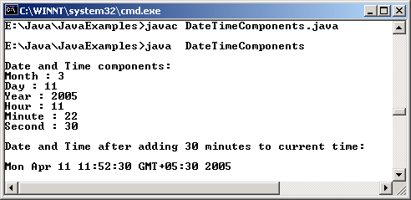
Example
import java.util.*;
class DateTimeComponents
{
public static void main(String [] args)
{
Calendar objCalendar = Calendar.getInstance();
// Display the Date and Time components
System.out.println("\nDate and Time components:");
System.out.println("Month : " + objCalendar.get(Calendar.MONTH));
System.out.println("Day : " + objCalendar.get(Calendar.DATE));
System.out.println("Year : " + objCalendar.get(Calendar.YEAR));
System.out.println("Hour : " + objCalendar.get(Calendar.HOUR));
System.out.println("Minute : " + objCalendar.get(Calendar.MINUTE));
System.out.println("Second : " + objCalendar.get(Calendar.SECOND));
// Add 30 minutes to current time,
// then display date and time
objCalendar.add(Calendar.MINUTE,30);
Date objDate = objCalendar.getTime();
System.out.println("\nDate and Time after adding 30 minutes to current time:\n");
System.out.println(objDate);
}
}
Output

Slide 10

Random class
This class generates random numbers.
Used when we need to generate numbers in an arbitrary or unsystematic fashion.
The two constructors are provided for this class are:
  One taking a seed value as a parameter
    Seed is a number that is used to begin random number generation
  The other takes no parameters
    Uses current time as seed

Slide 11
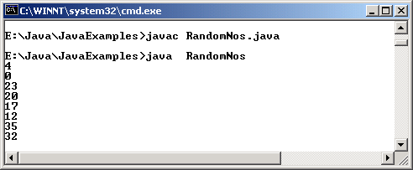
Example
import java.util.*;
class RandomNos
{
public static void main(String[] args)
{
while (true)
{
Random objRandom = new java.util.Random();
System.out.println(((objRandom.nextInt()/20000)>>>1)/1500);
try
{
Thread.sleep(500);
}
catch(InterruptedException e){ }
}
}
}
Output

Slide 12
BitSet class
BitSet represents a set of bits that grow dynamically.
It is a special type of array that holds bit values.
It defines the following constructors :
  BitSet() – Constructs an empty bitset
  BitSet(int numbits) – Constructs an empty bit set with the specified number of bits
BitSet instances can be compared for equality using equals() and can be converted to strings using toString()methods.

Slide 13
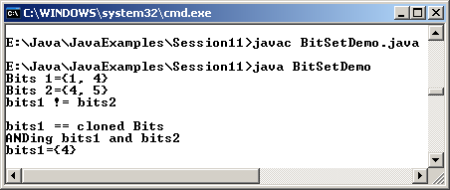
Example
import java.util.*;
public class BitSetDemo
{
public static void main (String args[])
{
BitSet objBit1 = new BitSet(20);
objBit1.set(1);
objBit1.set(4);
BitSet objBit2 = new BitSet(20);
objBit2.set(4);
objBit2.set(5);
// display the contents of these two BitSets
System.out.println("Bits 1 = " + objBit1.toString());
System.out.println("Bits 2 = " + objBit2.toString());
// test for equality of the two BitSets
if(objBit1.equals(objBit2))
System.out.println ("bits1 == bits2\n");
else
System.out.println ("bits1 ! = bits2\n");
// create a clone and then test for equality
BitSet clonedBits = (BitSet)objBit1.clone();
if(objBit1.equals(clonedBits))
System.out.println("bits1 == cloned Bits");
else
System.out.println("bits1 ! = cloned Bits");
// logically AND the first two BitSets
objBit1.and(objBit2);
System.out.println("ANDing bits1 and bits2");
// and display the resulting BitSet
System.out.println("bits1 = " + objBit1.toString());
}
Output

Slide 14
Collections API
Arrays are the simplest data structures.
Even if we create arrays of objects their limitation is that they have a fixed size.
It is not always possible to predict the size of arrays.
If a fixed size array is used and if the allocated memory is not fully made use of, it will be a waste.
To overcome this, programs need a means to create dynamic storage of information.

Slide 15
Collections API Contd…
Data structure is a means to store and organize information dynamically.
Data structures are mainly implemented through the Collections API.
This API has interfaces such as Collection, List and Set.
These form the foundation for classes such as ArrayList, LinkedList, HashSet, and so on.

Slide 16
The Collection Interface
The Collection interface lies at the top of the collections hierarchy.
A group of objects together are known as a collection.
Collections may or may not allow duplicate elements.
Some collections may contain ordered elements while some contain elements in any order.

Slide 17
List Interface
Extends the Collection interface.
Used to create lists of object references.
Provides additional methods to create a collection that stores elements in orderly fashion.
A List may contain duplicate elements.
The two general-purpose implementations of List are ArrayList and LinkedList.

Slide 18
Set Interface
Extends Collection and defines a set of elements similar to List.
Does not permit duplication of elements.
Used to create non-duplicate list of object references.
Does not define any additional methods of its own.

Slide 19
SortedSet
SortedSet extends Set interface.
Arranges elements in ascending order.
Used to create sorted list of non-duplicate object references.
SortedSet defines some additional methods in addition to the methods that it inherits from Collection.

Slide 20
Collection classes
ArrayList
  An ArrayList object is a variable length array of object references.
  Used to create dynamic arrays
  Extends AbstractList and implements List interface.
  ArrayLists are created with an initial size.
  As elements are added, size increases and the array expands.

Slide 21
Example
ButtonHandler handler = new ButtonHandler();
btnAdd.addActionListener(handler);
btnDelete.addActionListener(handler);
btnExit.addActionListener(handler);
addWindowListener(new WindowAdapter()
{
public void windowClosing(WindowEvent e)
{
System.exit(0);
}
} );
setSize(400,200);
show();
}
public static void main(String args[])
{
ArrayListDemo objArrayListDemo = new ArrayListDemo("Adding to Array List");
}
public void paint(Graphics g)
{
g.drawString("Size of array is " + objArray.size(),100,100);
}
import java.awt.*;
import java.awt.event.*;
import java.util.*;
class ArrayListDemo extends Frame
{
TextField txtName;
Label lblName = new Label("Name :");
Button btnAdd = new Button("Add");
Button btnDelete = new Button("Delete");
Button btnExit = new Button("Exit");
ArrayList objArray = new ArrayList();
public ArrayListDemo(String str)
{
super(str);
setLayout(new FlowLayout());
add(lblName);
txtName = new TextField(20);
add(txtName);
add(btnAdd);
add(btnDelete);
add(btnExit);

Slide 22
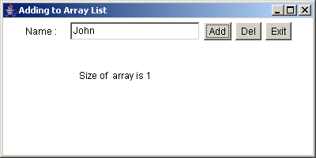
Example Contd…
class ButtonHandler implements ActionListener
{
public void actionPerformed(ActionEvent e)
{
String str = e.getActionCommand();
if(str.equals("Add"))
{
objArray.add(txtName.getText());
repaint();
}
else if(str.equals("Delete"))
{
objArray.remove(txtName.getText());
repaint();
}
else
{
System.exit(0);
}
}
}
}
Output

Slide 23
Collection classes Contd…
LinkedList
  A linked-list data structure is a list with each item having a link to the next item.
  There can be linear linked lists or circular linked lists.
  Linear linked lists end at some point whereas circular linked lists have the last element pointing back to the first element thus forming a circular chain.
  Extends AbstractSequentialList and implements the List interface.

Slide 24
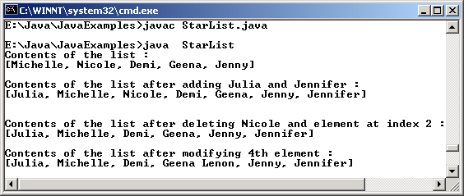
Example
import java.util.*;
class StarList
{
public static void main(String args[])
{
LinkedList llstStars = new LinkedList();
llstStars.add("Michelle");
llstStars.add("Nicole");
llstStars.add("Demi");
llstStars.add("Geena");
llstStars.add("Jenny");
System.out.println("Contents of the list :");
System.out.println(llstStars);
llstStars.addFirst("Julia");
llstStars.addLast("Jennifer");
System.out.println("\nContents of the list after adding Julia and Jennifer :");
System.out.println(llstStars);
System.out.println();
llstStars.remove(2);
llstStars.remove("Nicole");
System.out.println("\nContents of the list after deleting Nicole and element at index 2 :");
System.out.println(llstStars);
String strTemp = (String) llstStars.get(3);
llstStars.set(3, strTemp + " Lenon");
System.out.println("\nContents of the list after modifying 4th element :");
System.out.println(llstStars);
}
}
Output

Slide 25
Collection classes Contd…
HashSet
  Creates a collection that makes use of a hash table for storage.
  A hash table is a data structure that stores information by mapping the key of each data element into an array position or index.
  HashSet extends AbstractSet and implements the Set interface.

Slide 26
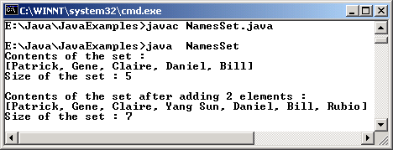
Example
import java.util.*;
public class NamesSet
{
public static void main(String args[])
{
Set objSet = new HashSet();
objSet.add("Patrick");
objSet.add("Bill");
objSet.add("Gene");
objSet.add("Daniel");
objSet.add("Claire");
System.out.println("Contents of the set :");
System.out.println(objSet);
System.out.println("Size of the set : " + objSet.size());
System.out.println("\nContents of the set after adding 2 elements :");
objSet.add("Rubio");
objSet.add("Yang Sun");
System.out.println(objSet);
System.out.println("Size of the set : " + objSet.size());
}
}
Output

Slide 27
The TreeSet Class
The TreeSet class also implements Set interface and uses a tree for data storage.
Objects are stored in sorted, ascending order and therefore accessing and retrieving an object is much faster.

Slide 28
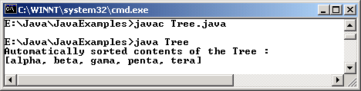
Example
import java.util.*;
class Tree
{
public static void main ( String []args)
{
TreeSet objTree = new TreeSet();
objTree.add("beta");
objTree.add("gama");
objTree.add("tera");
objTree.add("alpha");
objTree.add("penta");
System.out.println("Automatically sorted contents of the Tree : \n" + objTree);
}
}
Output

Slide 29
Legacy classes and interfaces
They formed the collections framework in the earlier versions of Java and have now been restructured or re-engineered.
The legacy classes defined by java.util package are:
  Dictionary (Obsolete)
  Hashtable
  Properties
  Stack
  Vector

Slide 30
Enumeration interface
Used to obtain a series of elements, one at a time in a collection of objects.
Defines two methods :
  boolean hasMoreElements() – Returns true if instance contains more elements and false if all the elements have been enumerated.
  Object nextElement() – Retrieves the next element as an object reference.

Slide 31
Hashtable
Hashtable is a data structure that organizes data based on a user defined key structure.
Typically makes use of hash codes which uniquely identify each element in the table.
Reduces the overhead involved in searching a particular element in a large set of data.
Useful to search data in large tables using a key than to search individual data element themselves.
Hashtable class extends the abstract Dictionary class and implements the Map, Serializable and Clonable interfaces.

Slide 32
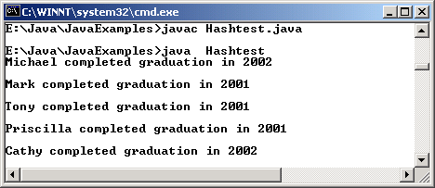
Example
import java.util.*;
class Hashtest
{
public static void main(String args[])
{
Hashtable htblStudents = new Hashtable();
Enumeration enuNames;
String strName;
htblStudents.put("Tony",new String("2001"));
htblStudents.put("Cathy",new String("2002"));
htblStudents.put("Michael",new String("2002"));
htblStudents.put("Priscilla",new String("2001"));
htblStudents.put("Mark",new String("2001"));
enuNames = htblStudents.keys();
while(enuNames.hasMoreElements())
{
strName = (String)enuNames.nextElement();
System.out.println(strName + " completed graduation in " + htblStudents.get(strName) + "\n");
}
}
}
Output

Slide 33
Properties class
Extends Hashtable and adds the capability to read and write a Hashtable object to a stream.
This class can be used to store keys and associated values.
Through its save() and load()method, a Properties object can be written to the disk.
An instance of the Properties can be created using one of the following constructors:
  Properties(): creates a new Properties object.
  Properties(Properties pdef): creates a new Properties object based on the specified default values.

Slide 34
Example
import java.util.*;
class ProductVendors
{
public static void main(String args[])
{
Properties proProducts = new Properties();
String strTemp;
proProducts.put("Turbo C","Borland");
proProducts.put("Flash MX","Macromedia");
proProducts.put("Java","Sun");
proProducts.put("3D Studio Max","Discreet");
proProducts.put("PhotoShop","Adobe");
proProducts.put("OS/2","IBM");
// Display properties without using an iterator
// or enumerator
proProducts.list(System.out);
// Search for non-existing element
strTemp = proProducts.getProperty("Oracle 9i","Not Present");
if (strTemp.trim().equals("Not Present"))
System.out.println("\nOracle 9i does not exist in the Products list");
// Copy the contents of proProducts to
// new Properties object
Properties proClone = new Properties();
Enumeration enuProductNames = proProducts.propertyNames();
String strKey = "";
while (enuProductNames.hasMoreElements())
{
strKey = (String)enuProductNames.nextElement();
proClone.setProperty(strKey,proProducts.getProperty(strKey));
}
// Copying done
System.out.println("\nDisplaying cloned Properties object :\n");
proClone.list(System.out);
}
}

Slide 35
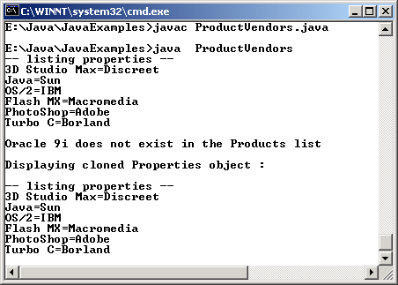
Example Contd…
Output

Slide 36
Vector class
If there is a need to have an array-like data structure that can store object references and is dynamic, we can make use of the Vector class.
At any given point of time, an instance of type Vector has the capacity to hold a certain number of elements.
When it becomes full, its capacity is incremented by an amount specific to that Vector object.

Slide 37
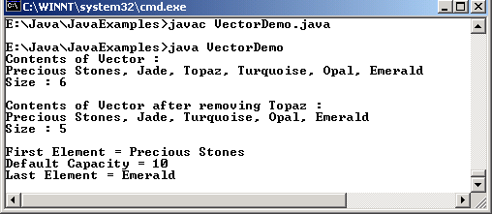
Example
import java.util.*;
public class VectorDemo
{
public static void main (String args[])
{
Vector v = new Vector();
v.addElement("Jade");
v.addElement("Topaz");
v.addElement("Turquoise");
v.addElement("Emerald");
v.insertElementAt("Precious Stones",0);
v.insertElementAt("Opal",4);
System.out.println("Contents of Vector :");
int count = 0;
while(count < v.size())
{
System.out.print(v.elementAt(count));
count++;
if(count < v.size())
System.out.print(", ");
}
System.out.println("\nSize : "+ v.size());
v.removeElement("Topaz");
System.out.println("\nContents of Vector after removing Topaz :");
count = 0;
while(count < v.size())
{
System.out.print(v.elementAt(count));
count++;
if(count < v.size())
System.out.print(", ");
}
System.out.println("\nSize : " + v.size());
System.out.println("\nFirst Element = " + v.firstElement());
System.out.println("Default Capacity = " + v.capacity());
System.out.println("Last Element = " + v.lastElement());
}
}
Output

Slide 38
Stack class
Extends the Vector class.
Used to create a simple last-in-first-out stack.
An item is stored on a stack by ‘pushing’ it into the stack.
An item may subsequently be ‘popped’ off the stack and used.
A Stack object will grow in size as new items are pushed onto it.

Slide 39
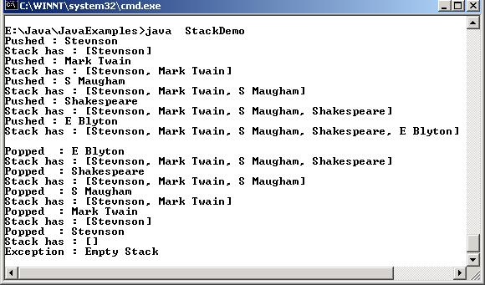
Example
public static void main (String args[])
{
StackDemo objStackDemo = new StackDemo();
objStackDemo.pushItem("Stevnson");
objStackDemo.pushItem("Mark Twain");
objStackDemo.pushItem("S Maugham");
objStackDemo.pushItem("Shakespeare");
objStackDemo.pushItem("E Blyton");
System.out.println();
objStackDemo.popItem();
objStackDemo.popItem();
objStackDemo.popItem();
objStackDemo.popItem();
objStackDemo.popItem();
try
{
objStackDemo.popItem();
}
catch(EmptyStackException e)
{
System.out.println("Exception : Empty Stack");
}
}
}
import java.util.*;
public class StackDemo
{
Stack s;
public StackDemo()
{
s = new Stack();
}
void pushItem(String str)
{
s.push(str);
System.out.println("Pushed : " + str);
System.out.println("Stack has : " + s);
}
void popItem()
{
String str = (String)s.pop();
System.out.println("Popped : " + str);
System.out.println("Stack has : " + s);
}
Output

Slide 40
Map interfaces and classes
A map is an object, which stores data in the form of relationships between keys and values.
Keys and values are in the form of objects.
Following are the map interfaces:
  Map: maps unique keys to values
  Map.Entry: describes a key/value pair in a map
  SortedMap: extends the map interface and ensures that entries are maintained in ascending order

Slide 41
Map interfaces and classes
Contd…
Following are the classes that implement Map interface:
  AbstractMap - Implements most of the Map interface
  HashMap - Subclass of AbstractMap; used to create
  hash tables
  TreeMap - Subclass of AbstractMap; used to create
  trees
  WeakHashMap -Subclass of AbstractMap; used to create
  hash tables with weak keys

Slide 42
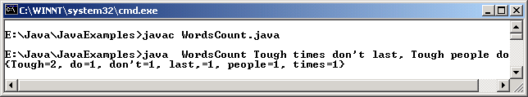
Example
/* If the word does not exists in the map
then initialize frequency to 1
else increment it by 1
*/
if(frequency == null)
{
frequency = new Integer(1);
}
else
{
int value = frequency.intValue();
frequency = new Integer(value + 1);
}
// Update the frequency for the word
// referred by "key"
WordList.put(key, frequency);
}
// Display the words and its
// corresponding frequency
Map sortedWordList = new TreeMap(WordList);
System.out.println(sortedWordList);
}
}
import java.util.*;
public class WordsCount
{
public static void main(String args[])
{
if(args.length < 1)
{
System.out.println("Usage : java WordsCount <sample string>");
System.exit(0);
}
Map WordList = new HashMap();
for(int count = 0;count < args.length; count++)
{
// Get the next word
String key = args[count];
// Get the frequency of the word
// referred by "key"
Integer frequency = (Integer)WordList.get(key);
Output

Slide 43
The Regular Expressions
Regular Expression is a new features added in Java’s latest version.
It is found in java.util package.
Regular expression also known as ‘regex’ is a set of symbols and syntactic elements which are used to match patterns in a text.
They are mainly used for manipulating text such as find, find and replace and so on.
Pattern and Matcher are the two classes supporting regular expression processing. These two classes work together.
Pattern class is used to define a regular expression and Matcher class is used to match the pattern against another character sequence.

Slide 44
Pattern Class
The Pattern class has no constructors of its own.
By calling one of its public static method compile(), a Pattern object is created.
The syntax of the method is as follows:
  static Pattern compile(String pattern)
The String pattern is a regular expression which is compiled to create an object of Pattern class that can be used for pattern matching by the Matcher class.

Slide 45
Matcher Class
Matcher class like Pattern class does not have any constructors.
A matcher object is created by calling the public matcher() method defined in Pattern class.
Once a matcher object is created we can perform different kinds of match operations.

Slide 46
Matcher Class Contd…
Different match operations are:
  boolean matches(): It is one of the most simple method. It tries to match the entire input sequence against the pattern.
  boolean lookingAt (): It tries to match the input sequence against the pattern starting from beginning.
  boolean find (): It scans the input sequence looking for the next subsequence that matches the pattern or it tries to find if a subsequence of input sequence matches the pattern.

Slide 47
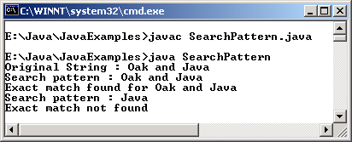
Example
import java.util.regex.*;
public class SearchPattern
{
public static void main(String args[])
{
String strText = "Oak and Java";
System.out.println("Original String : " + strText);
System.out.println("Search pattern : " + strText);
Pattern ptnSearch = Pattern.compile(strText);
Matcher mtrText = ptnSearch.matcher(strText);
if(mtrText.matches())
System.out.println("Exact match found for " + strText);
else
System.out.println("Exact match not found");
mtrText = ptnSearch.matcher("Java");
System.out.println("Search pattern : " +"Java");
if(mtrText.matches())
System.out.println("Exact match found for " + "Java");
else
System.out.println("Exact match not found");
}
}
Output

Slide 48
Regular Expression Syntax
Regular expression consists of :
  normal characters
  character classes
  wildcard characters
  quantifiers
A normal character will be matched as it is.
A character class is a set of characters.
In predefined character class a dot ‘.’ represents a wildcard character and it matches any character.
A quantifier determines how many times an expression matches.

Slide 49
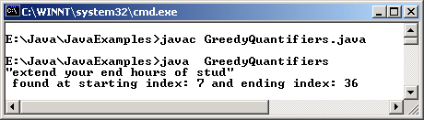
Greedy Quantifiers
Force the matcher object to take the entire input string as one before attempting even the first match.
If the entire input string fails, the matcher will leave one character from the input string until a match is found or there are no more characters left to back off from.
import java.util.regex.*;
public class GreedyQuantifiers
{
public static void main(String args[])
{
Pattern ptnSearch;
Matcher mtrText;
/* Create the longest pattern
which begins with the alphabet e
followed by any characters and ends with d
*/
ptnSearch = Pattern.compile("e.+d");
mtrText = ptnSearch.matcher("Kindly extend your end hours of study ");
while(mtrText.find())
{
System.out.println("\"" + mtrText.group() + "\"");
System.out.println(" found at starting index: " + mtrText.start() + " and ending index: " + mtrText.end());
}
}
}
Output

Slide 50
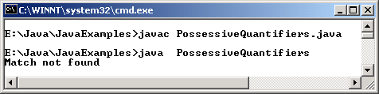
Reluctant Quantifier
Starts from the beginning of the input string, and then reluctantly accepts one character at a time looking for a match.
Reluctant behavior is specified by adding ? quantifier to the pattern.
import java.util.regex.*;
public class ReluctantQuantifiers
{
public static void main(String args[])
{
Pattern ptnSearch;
Matcher mtrText;
ptnSearch = Pattern.compile("e.+?d");
mtrText = ptnSearch.matcher("Kindly extend your end hours of study");
while(mtrText.find())
{
System.out.println("\"" + mtrText.group() + "\"");
System.out.println(" found at starting index: " + mtrText.start() + " and ending index: "+ mtrText.end());
}
}
}
Output

Slide 51
Possessive quantifiers
Takes the entire input String once and only once for a match.
They never back off like greedy quantifiers.
Possessive behavior is specified by placing + symbol before the pattern.
import java.util.regex.*;
public class PossessiveQuantifiers
{
public static void main(String args[])
{
Pattern ptnSearch;
Matcher mtrText;
boolean found = false;
ptnSearch = Pattern.compile("e.++d");
mtrText = ptnSearch.matcher("Kindly extend your end hours of study ");
while(mtrText.find())
{
found = true;
System.out.println("\"" + mtrText.group() + "\"");
System.out.print(" found at starting index: " + mtrText.start() + " and ending index: " + mtrText.end());
}
if(!found)
System.out.println("Match not found");
}
}
Output

Slide 52
Timer and TimerTask
These two classes have been added in the java.util package.
It allows a programmer to schedule a task for execution at future time.
We can schedule a task for a specific date as well as schedule it in such a way that it is executed repeatedly. Both these classes work together.
Timer class is used to schedule a task for execution and the task which is being scheduled should be an object of TimerTask.
TimerTask implements the Runnable interface and thus it creates a thread of execution.

Slide 53
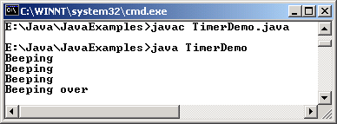
Example
class TimerDemo
{
public static void main(String [] args)
{
Task t = new Task();
/* Schedule the timer to perform
task t every 500 milliseconds.
Start the timer after 1000 milliseconds
*/
Timer tmr = new Timer();
tmr.schedule(t, 1000, 500);
try
{
Thread.sleep(5000);
}
catch (InterruptedException e)
{
}
System.out.println("Beeping over");
// Stop the timer
tmr.cancel();
}
}
import java.util.*;
import java.awt.*;
class Task extends TimerTask
{
int num = 3;
Toolkit kit = Toolkit.getDefaultToolkit();
public void run()
{
if (num > 0)
{
kit.beep();
System.out.println("Beeping");
num--;
}
}
}
Output

Slide 54
Summary
The java.util package provides a miscellany of classes and interfaces such as Date, Calendar, BitSet besides providing the collection framework.
The classes Date, Calendar, Random and BitSet form the utility classes of the java.util package.
The class BitSet represents a dynamically sized set of bits.
The Collection interface provides common methods for all the collection classes and mechanisms to insert new objects into the collection.
The Collection interface is extended by List and Set interfaces respectively. Lists are similar to Sets except that Sets do not permit duplication of elements.

Slide 55
Summary Contd…
The SortedSet interface extends Set and is used to store elements in ascending order.
The ArrayList class extends AbstractList and implements the List interface. An ArrayList object is a variable length array of object references and is used to create dynamic arrays.
The LinkedList class extends AbstractSequentialList and implements the List interface. It is used to create a linked-list data structure.
HashSet extends AbstractSet and implements the Set interface. It creates a collection that makes use of a hash table for storage
Legacy classes and interfaces are the classes and interfaces that formed the collections framework in the earlier versions of Java

Slide 56
Summary Contd…
Dictionary,Hashtable,Properties,Stack ,Vector are the legacy classes. Dictionary is obsolete and no longer used.
A map is an object, which stores data in the form of relationships between keys and values.
Map, Map.Entry, SortedMap are the Map interfaces while AbstractMap, HashMap, TreeMap and WeakHashMap are classes that implement Map Interface.
Pattern and Matcher are the two classes supporting regular expression processing. These two classes work together.
Pattern class is used to define a regular expression and Matcher class is used to match the pattern against another character sequence.
Timer and TimerTask are two classes that have been added in the java.util package. It allows a programmer to schedule a task for execution at future time.

